Slide 1
Module 4:
Change Control & Contract management

Slide 2
Change Control
Change control is a systematic approach to managing all changes made to a product or system.
The purpose is to ensure that no unnecessary changes are made, that all changes are documented, that services are not unnecessarily disrupted and that resources are used efficiently.
Within information technology (IT), change control is a component of change management.

Slide 3
Change Control Procedures
One or more users might perceive the need for a change.
User management decide that the change is valid and worthwhile and pass it to development management.
A developer is assigned to assess the practicality and cost of making the change.
Development management report back to user management on the cost of the change; user management decide whether to go ahead.

Slide 4
Cont..
One or more developers are authorized to make copies of components to be modified
Copies modified.
After initial testing, a test version might be released to users for acceptance testing
When users are satisfied then operational release authorized – master configuration items updated

Slide 5
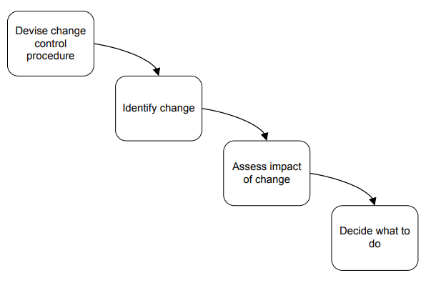
Change Control

Slide 6
Managing Contract
Successful contract management covers the period from the beginning of a procurement until after a contract ends. The receipt of goods and services at the right price, quality, and on time as well as proper compensation of the contractor is the goal of a successful procurement.
However, poor contract management often results in end-user frustration, reluctance to use new vendors, agency acceptance of poor quality service or goods, increased costs due to lack of quality or overpayment to contractors, lack of contractor accountability, and generally poor contractor performance.
A good contract is a means to an end. Simply enforcing the contract, however, does not necessarily result in a successful relationship with the contractor. Success should instead be measured by the effectiveness of the program that the contract supports.

Slide 7
Type of contracts
Acquiring software from external supplier could be:
a bespoke system – a system that is created from scratch specially for one customer
Commercial off-the-shelf (COTS) - bought ‘as is’ – sometimes referred as shrink wrapped software. Ready made software product that you purchase as opposed to custom made software that is designed for a specific purpose
customized off-the-shelf - a basic core system which is customized to meet needs of a particular customer

Slide 8
Commercial off-the-shelf
Software or hardware products that are ready-made and available for sale to the general public.
For example, Microsoft Office is a COTS product that is a packaged software solution for businesses.
COTS products are designed to be implemented easily into existing systems without the need for customization.

Slide 9
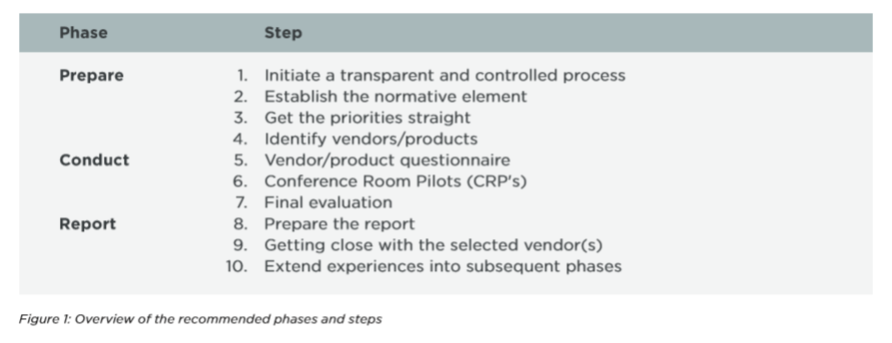
Selecting & Acquiring the best Commercial Off The Shelf (COTS) software product

Slide 10
Selecting & Acquiring..
Initiate a transparent and controlled process:
It is important to acknowledge that the process of selecting a COTS software product must be transparent and controlled. This means that adequate time must be set aside, a relevant assessment method must be established and agreed upon, and key stakeholders must have adequate time for involvement.
Establish the normative element:
Without a clear understanding of what the product must support in terms of business processes and regulations, it is impossible to carry out a vendor and product evaluation that is aligned with business goals.

Slide 11
Selecting & Acquiring..
Get your priorities straight:
When planning vendor and product assessments, it is important to understand the priorities. Consider grouping measurement-points into priority-groups, such as business imperatives, financials, industry focus, support for regulatory compliance, reputation/ awareness, business process support and technical architecture.
Identify vendors/products:
List the potential candidates. Discuss with key stakeholders and with your team. To identify potential candidates, use your network in other organisations to learn about the type of software they use, search for information on the internet, and consider purchasing reports from analyst companies – they might save you a lot of time.

Slide 12
Selecting & Acquiring..
Vendor/product questionnaire
Based on the priorities, prepare an initial vendor/ product questionnaire to gain a first impression of the vendor’s behaviour and the product’s capabilities.
Conference Room Pilots
Once you’ve evaluated the questionnaires, you should be in a position to invite qualified vendors to attend a Conference Room Pilot (CRP). Allocate a few days for this process, and make sure that the product presentations are relatively close together. This will make it easier to remember product details and make comparisons.

Slide 13
Selecting & Acquiring..
Final evaluation:
Consider developing a spreadsheet-based tool to capture the final vendor and product assessments.
Preparing the report:
Although spreadsheets can be very useful, management will typically require a Word or PowerPoint based report.
Get close to a few vendors – or even just one:
Once the initial screening is complete, you should have a few – or perhaps only one – vendor to continue working with.
Let the evaluation method inspire the contract, user requirements specification and project follow-up:
Eventually – but not always – the product assessment ends in concrete negotiations with a selected vendor about a particular product.

Slide 14
Type of Contract
Another way of classification based on the way of payment to supplier:
fixed price contracts
time and materials contracts
fixed price per delivered unit
Note difference between goods and services.
Often license to use software is bought rather than the software itself.

Slide 15
Fixed price contracts
Advantages to customer
known expenditure
supplier motivated to be cost-effective
Disadvantages
supplier will increase price to meet contingencies
difficult to modify requirements
upward pressure on the cost of changes
threat to system quality

Slide 16
Time and materials
The customer is charged at a fixed rate per unit of effort. Ex: per staff-hour.
Advantages to customer
easy to change requirements
lack of price pressure can assist product quality
Disadvantages
Customer liability - the customer absorbs all the risk associated with poorly defined or changing requirements
Lack of incentive for supplier to be cost effective

Slide 17
Fixed price per unit delivered
This is often associated with function point(FP) counting.
The size of the system to be delivered might be estimated in lines of code, but FP's can be more easily and reliably derived from requirement specifications.

Slide 18
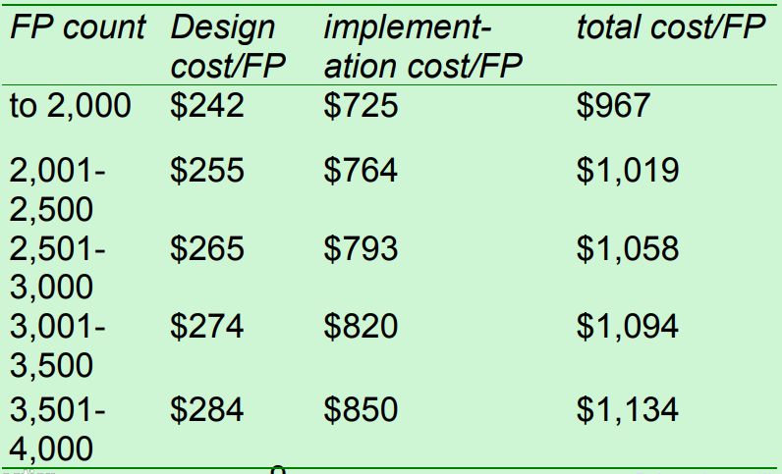
Ex:

Slide 19
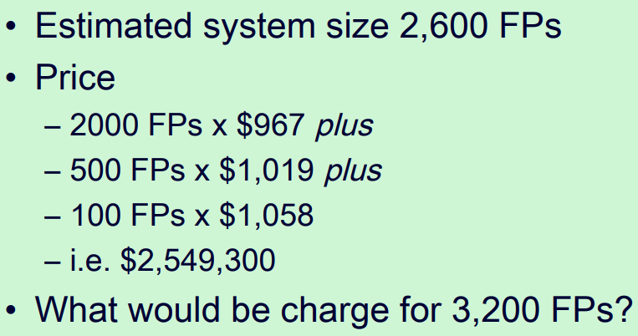
Ex:

Slide 20
Fixed price/unit
Advantages for customer
customer understanding of how price is calculated
comparability between different pricing schedules
emerging functionality can be accounted for
supplier incentive to be cost-effective
Disadvantages
difficulties with software size measurement - may need independent FP counter
changing (as opposed to new) requirements: how do you charge?

Slide 21
The tendering process
Open tendering
any supplier can bid in response to the
invitation to tender
all tenders must be evaluated in the same way
government bodies may have to do this by local/international law

Slide 22
The tendering process
Restricted tendering process
bids only from those specifically invited
can reduce suppliers being considered at any stage
Negotiated procedure
negotiate with one supplier e.g. for extensions to software already supplied

Slide 23
Stages in contract placement
requirements analysis
evaluation plan
invitation to tender
evaluation of proposals

Slide 24
Requirements document: sections
introduction
description of existing system and current environment
future strategy or plans
system requirements
mandatory/desirable features
deadlines
additional information required from bidders

Slide 25
Requirement
These will include
functions in software, with necessary inputs and outputs
standards to be adhered to
other applications with which software is to be compatible
quality requirements e.g. response times

Slide 26
Evaluation plan
How are proposals to be evaluated?
Methods could include:
reading proposals
interviews
demonstrations
site visits
practical tests

Slide 27
Evaluation plan
Need to assess value for money for each desirable feature
Example:
feeder file saves data input
4 hours a month saved
cost of inputter £20 an hour
system to be used for 4 years
if cost of feature £1000, would it be worth it?

Slide 28
Invitation to tender (ITT)
Note that bidder is making an offer in response to ITT
acceptance of offer creates a contract
Customer may need further information
Problem of different technical solutions to the same problem

Slide 29
Memoranda of agreement (MoA)
Customer asks for technical proposals
Technical proposals are examined and discussed
Agreed technical solution in MoA
Tenders are then requested from suppliers based in MoA
Tenders judged on price
Fee could be paid for technical proposals by customer

Slide 30
Contract management
Contracts should include agreement about how customer/supplier relationship is to be managed e.g.
decision points - could be linked to payment
quality reviews
changes to requirements

